Slide 1
istorage
Understanding your business

Slide 2
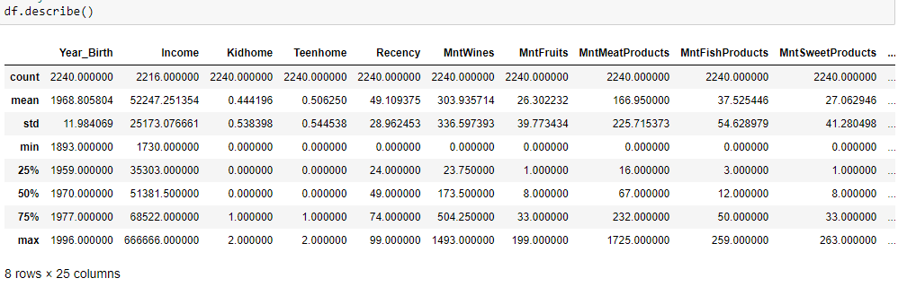
To do so, i will analyse this dataset
As we see in “count”, there is actually 2240 entries on this dataset.
Unfortunately, apparently not all Income were computed, but still this is a good dataset to work on.

Slide 3
Get to know your clients
What makes your clients come to you?
Wich client have each preference?
Can you help them remember They need your help?

Slide 4
Let me help you answer those questions

Slide 5
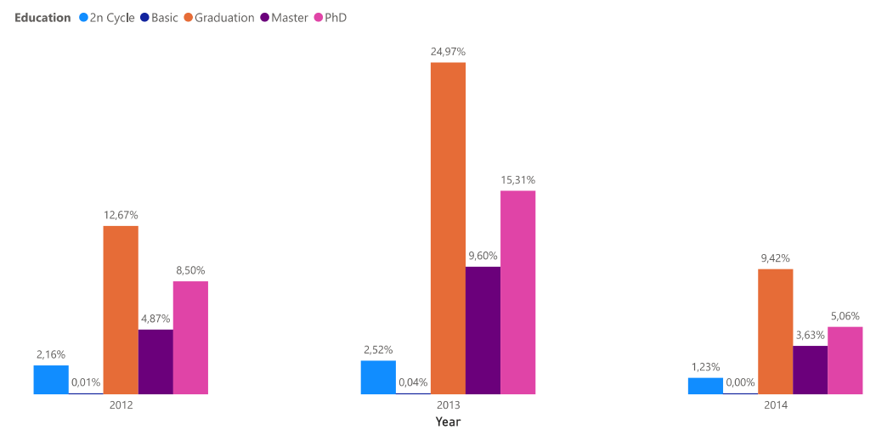
Can we use the education of our clients to predict their behavior?
TO THAT, THE ANSWER IS YES!

Slide 6
EXPLORATORY ANALYSIS
Wich are the VARIABLES TO BUILD A MODEL?
How TO TRAIN AND PROVIDE INTELLIGENCE FOR YOUR BUSINESS if you dont know wich variables depend on each Other?

Slide 7
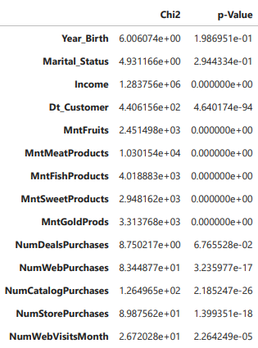
chi-square
There is a dependency between “Education” and “Year_Birth”
There is also a dependency between “Education and “Marital_Status” This means Education could be a potencial variable to use on a Machine Learning Model to predict customers purchase behaviors.

Slide 8
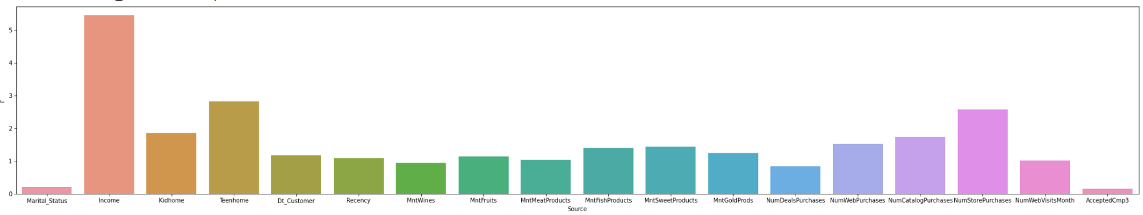
ANOVA – Analysis of variance
Unlikely the chi analysis, the ANOVA analysis seems to put the “income” as the most important variable on the building of a model.
The other relevant variables are: “Teenhome”, “NumStorePurchases”, “Kidhome” and “NumWebPurchases”

Slide 9
But now what? How is that useful?
Now we can actually predict how a random customer would have their behavior regardless their previous purchases on your store

Slide 10

This is peter
Peter is 55 years old;
PhD in physics
Married;
Has 2 teens home
Has an income of 70k an year

Slide 11
Why talk about peter?
If we can predict how Much peter would drink of wine in one year,
Or how Much he would spend on meat
Then we can predict how Much ANYone can spend on anytime in anything.

Slide 12
Now let’s talk business
WE have a lot of work to do here:
As a data analyst, i advice you to get a data scientist we can work with so he can help me modeling a machine learning Project wich could help us answer some questions, example:
How does education+Marital_Status+year_birth defines purchases?
How income+teenhome defines the purchases of fruits, wines, meat, etc?

Slide 13

let’s see some

Slide 14
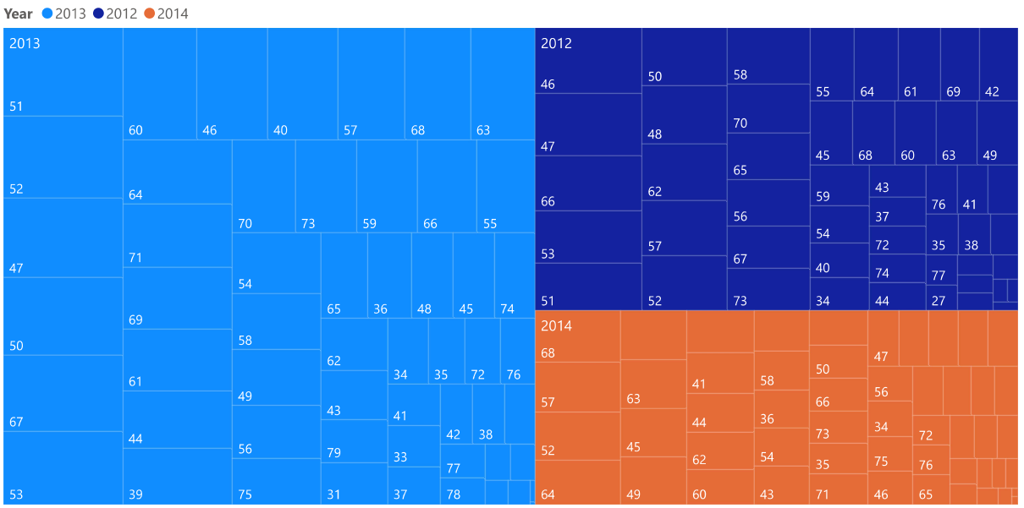
Did you know your average client’s age is about 45 to 60 Years old?

Slide 15
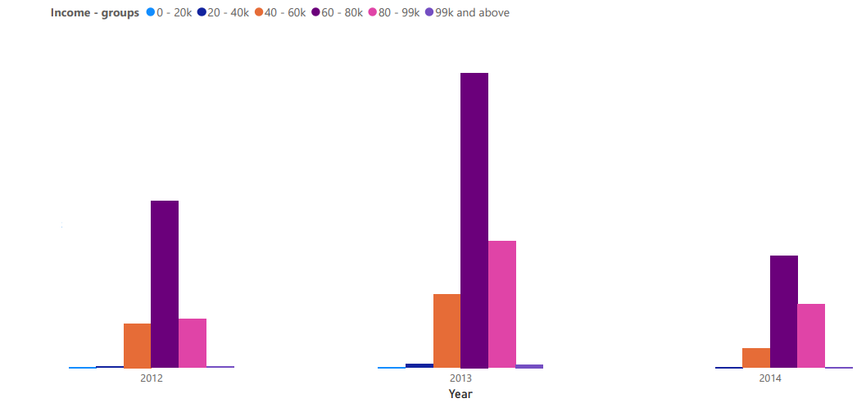
Does the income of your client influence ON their purchases?
SURE IT DOES! IT IS NECESSARY TO PREDICT THEIR NEXT PURCHASES!

Slide 16
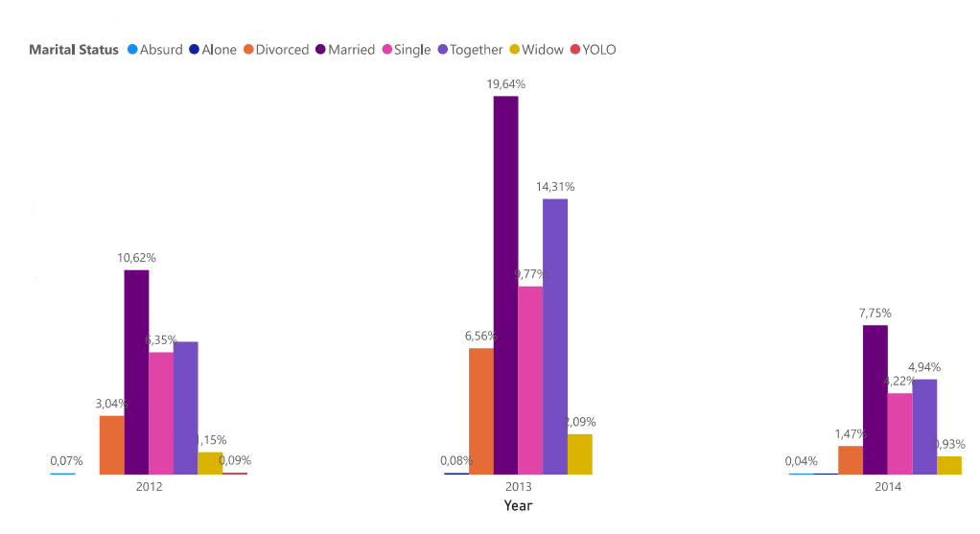
And your marital status influence on the things you buy?
YES! AND WE NEED TO UNDERSTAND HOW

Slide 17
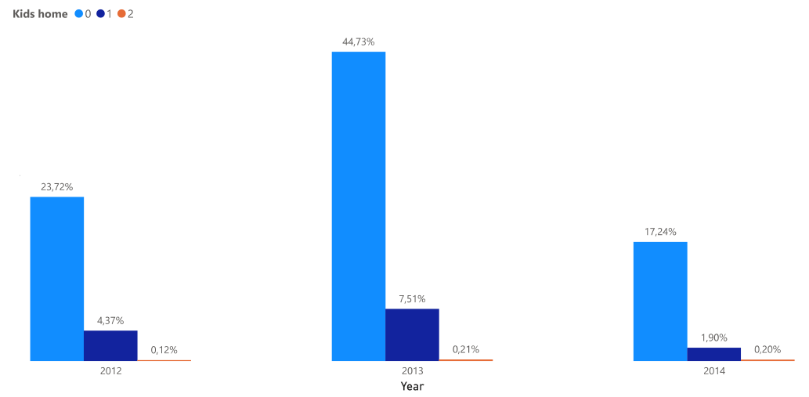
Did you know? More kids = Less Purchases

Slide 18
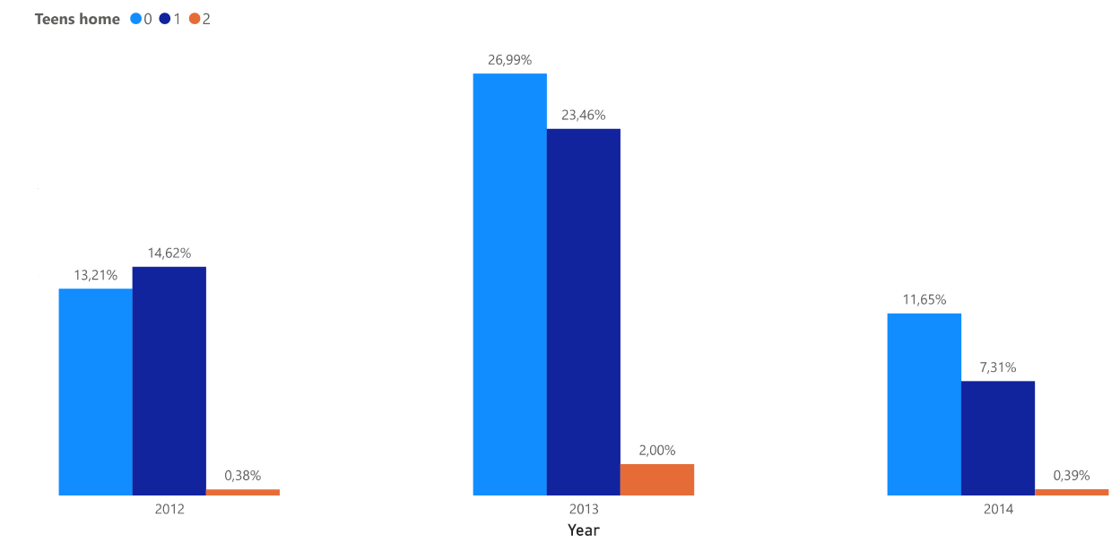
And if They are not kids, but teens, does it change anything?

Slide 19
The results were from wine
All the results examples were from wine. So you can think: more kids, less wine, that makes sense, right?
But the kids would need, i don’t know... More meat? No.
The data shows this pattern of charts for Every single type of purchase on the dataset.

Slide 20
So what can we conclude?
We can use these visualizations to create specific marketing strategics
Knowing what influences purchases the most and not pursuing your goal to be something that can not be achieved

Slide 21
Thank you

